Slide 1
Teaching and Learning Theme 2 – Efficient revision
Magnus Anderson
Senior Deputy Head

Slide 2
Why this theme?
Revision is something that pupils, parents and teachers talk about a lot
But what do people mean when we say “revision”…
…and how can you revise efficiently?

Slide 3
Revision as an iterative process that builds on work you have already done
Refining understanding
Memorising content
Exam success!
Developing skills

Slide 4
The best way to memorise content is by practice testing
Content
Create flashcards (electronic or physical) with question on one side and answer on the other – use to self test
With a friend: ask questions, make quizzes, or create ‘fill the gap’ exercises, for one another
Close your books and write everything you know on a topic – then check it
Do past exam papers (see skills development)

Slide 5
Developing the skills to answer structured questions is best done using PPQs
Skills
Answer PPQs under controlled conditions…
...then mark against the mark scheme…
…to understand where (and why) you went wrong

Slide 6
Developing the skills for essay questions means writing essay plans
Skills
The best way to develop this skill is to write detailed essay plans… then mark them or discuss with your teacher
You need to understand what makes a good essay in that subject (e.g. selection of evidence, depth of analysis, evaluation)
Reading model essays, or those of a friend, can be really valuable

Slide 7
Revision is likely to expose gaps in your understanding
Understanding
You should have good understanding from the course, but this may have faded over time
To refine your understanding, you can use:
  Your course notes and feedback
  Quality online content, revision guides and textbooks
  Revision clinics and help clubs
Don’t reinvent the wheel!

Slide 8
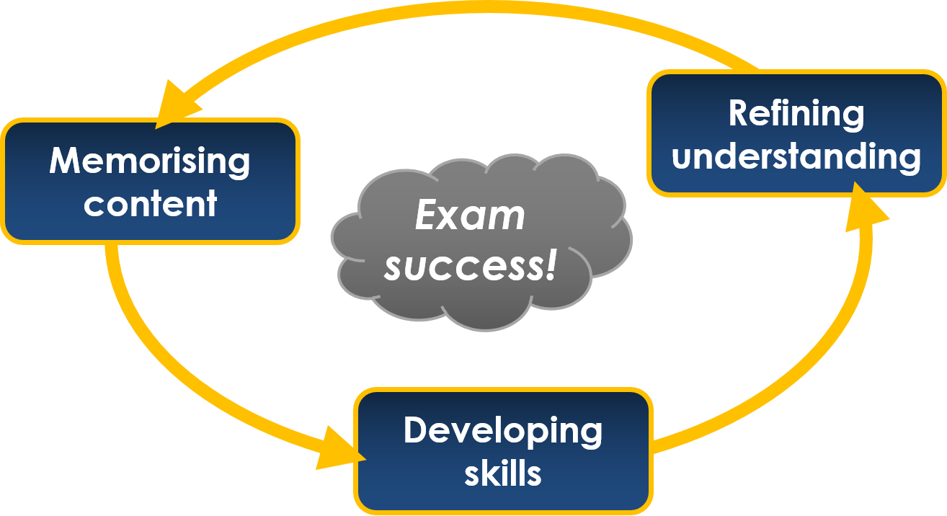
So you know what to do, but how should you do these three activities?

Slide 9
Arrange things to make your revision as efficient as possible…
Revision is hard work! Make sure you eat well, take exercise and get enough sleep
Multi-tasking is a myth: you can only revise efficiently without distractions…
…every “bleep” costs minutes of lost focus

Slide 10
…and don’t take inefficient or ineffective approaches
Inefficient
Ineffective
Re-reading notes
Writing summary notes (unless done in a way that allows self-testing)
Copying notes out
Excessive focus on “learning styles”

Slide 11
Teachers will all provide revision guidance for their subject (Y6 – 10)
Checklist of content to memorise
Links to practice questions for skills development
Resources for refining understanding
  Reminder of materials you already have
  Good online content
  Help available in school

Slide 12
And finally, remember that…
End of year exams are only one part of your learning
If you revise well and try your best you will learn a lot from the process
Your final mark is much less important than what you learn along the way

